Slide 1

Extracting data from Twitter in R

Slide 2
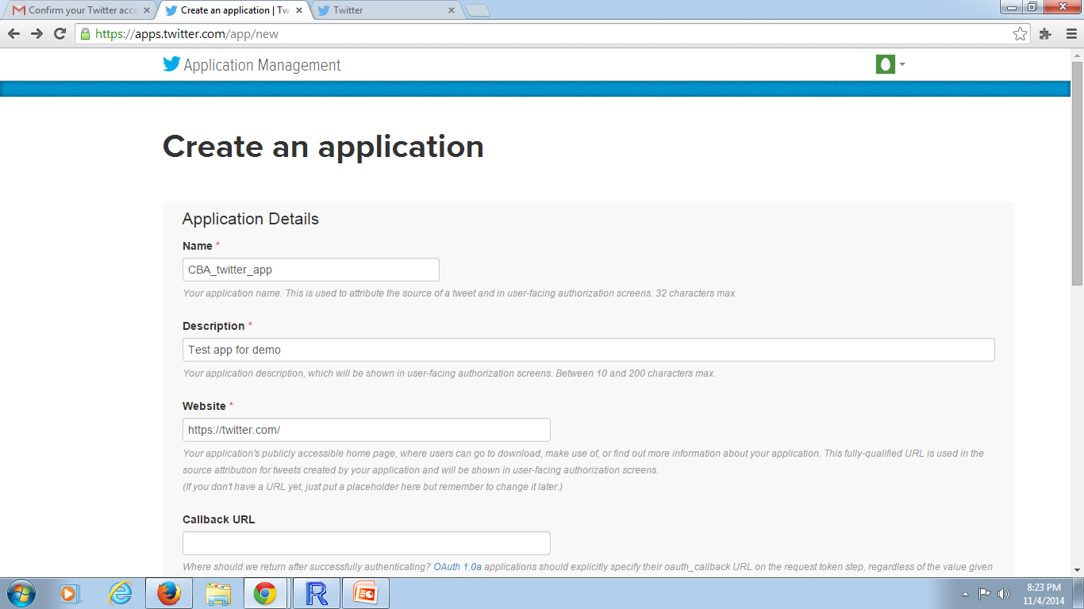
Twitter Authentication with R
One should have a Twitter account to pull the data in R (If you don’t have one , first signup on twitter.com )
Got to https://apps.twitter.com/ and log in with your Twitter Account
Now click on Create new application and enter the details. In website you can enter any valid url for page redirect. (https://twitter.com/ in this case)
leave the Callback URL blank

Slide 3
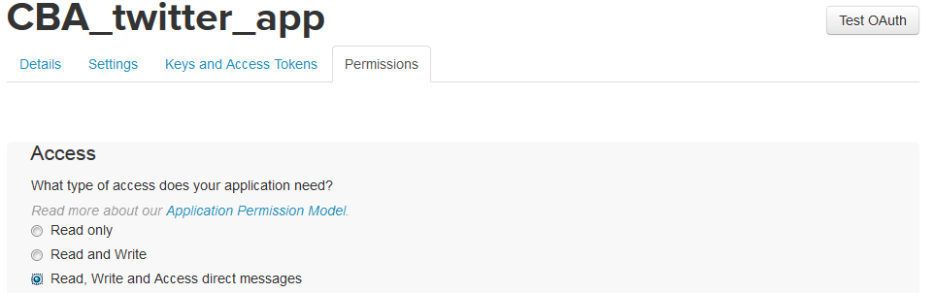

Scroll down , accept the license agreement and click on create your twitter application. It will be redirected to app page with all the OAuth setting of your new App
Now click on Permissions and change it to Read, Write and Access direct messages and update settings
Now click on Keys and Access Tokens to see the settings which are required in R code. Scroll down and click on create my access token

Slide 4
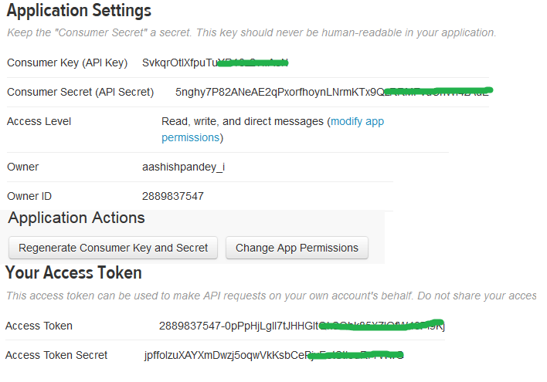
Replace these settings in R code

Slide 5
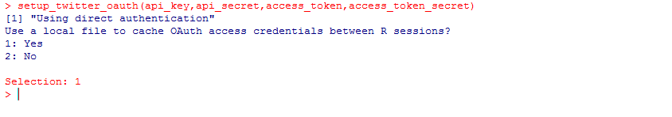
Open R session and use below code for authentication in R. Replace api_key, api_secret, access_token and access_token_secret with your app settings
require("twitteR")||install.packages("twitteR")
library(twitteR)
api_key <- “xxxxxxxxxxxxxxx" #Consumer key: *
api_secret <- “xxxxxxxxxxxxxxxxxxxxxxxxx" # Consumer secret: *
access_token <- “xxxxxxxxxxxxxxxxxxxxxxxxxxxxxxx" # Access token:
access_token_secret <- “xxxxxxxxxxxxxxxxxxxxxxxxxxxxxxxxx" # Access token secret:
# After this line of command type 1 for selection as Yes
setup_twitter_oauth(api_key,api_secret,access_token,access_token_secret)

Slide 6
Extracting tweets from hashtag(#)
Use below code for extracting tweets and storing in local machine
Replace #wontgiveitback with desired hashtag and change file name indiawc.txt to your file output name
All the tweets data will be store in your working directory
tweets = searchTwitter('#wontgiveitback', n=1000)
tweets.df = twListToDF(tweets)
write.table(tweets.df, file='indiawc.txt', row.names=F, sep="\t")

